Slide 1
LiDAR Fundamentals: Part One L. Monika Moskal, PhD Assistant Professor - Remote Sensing & Biospatial Analysis College of Forest Resources & Precision Forestry Cooperative University of Washington Workshop on Site-scale Applications of LiDAR on Forest Lands in Washington Center for Urban Horticulture, UW Thursday, January 3, 2008
Notes:
‹#›

Slide 2
LiDAR: What and Why?
LiDAR stands for Light Detection and Ranging, commonly known as Laser Radar
LiDAR is not only replacing conventional sensors, but also creating new methods with unique properties that could not be achieved before
Discrete LiDAR
Notes:
‹#›

Slide 3
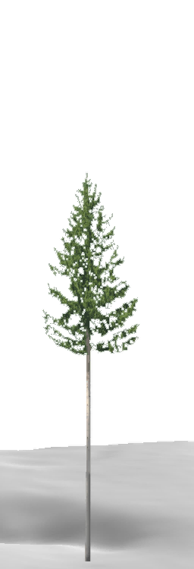
LiDAR: How?
Each time the laser is pulsed:
Laser generates an optical pulse
Pulse is reflected off an object and returns
to the system receiver
High-speed counter measures the time of flight from the start pulse to the return pulse
Time measurement is converted to a distance (the distance to the target and the
position of the airplane is then used to determine
the elevation and location)
Multiple returns can be measured for each pulse
Up to 200,000+ pulses/second
Everything that can be seen from the aircraft
is measured
Notes:
‹#›

Slide 4
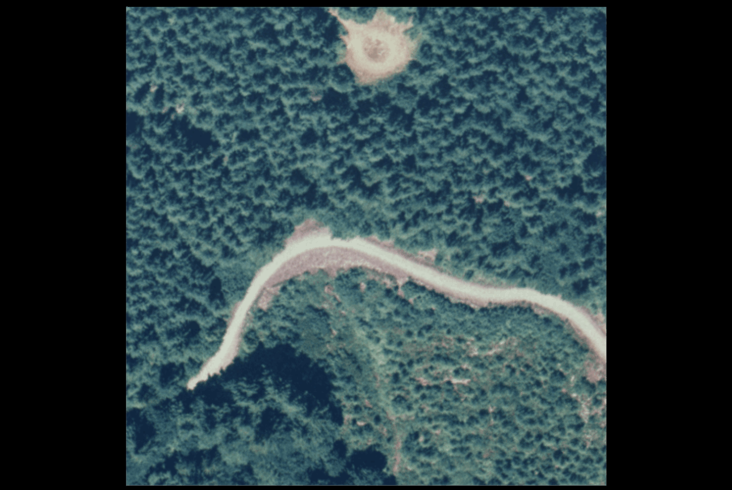
Notes:
‹#›

Slide 5
Traditional Photogrammetry vs. LiDAR
LiDAR | Photogrammetric
Day or night data acquisition | Day time collection only
Direct acquisition of 3D collection | Complicated and sometimes unreliable procedures
Vertical accuracy is better than planimetric* | Planimetric accuracy is better than vertical*
Point cloud difficult to derive semantic information; however, intensity values can be used to produce a visually rich image like product (example of an intensity image) | Rich in semantic information
*Complementary characteristics suggest integration
Notes:
‹#›

Slide 6
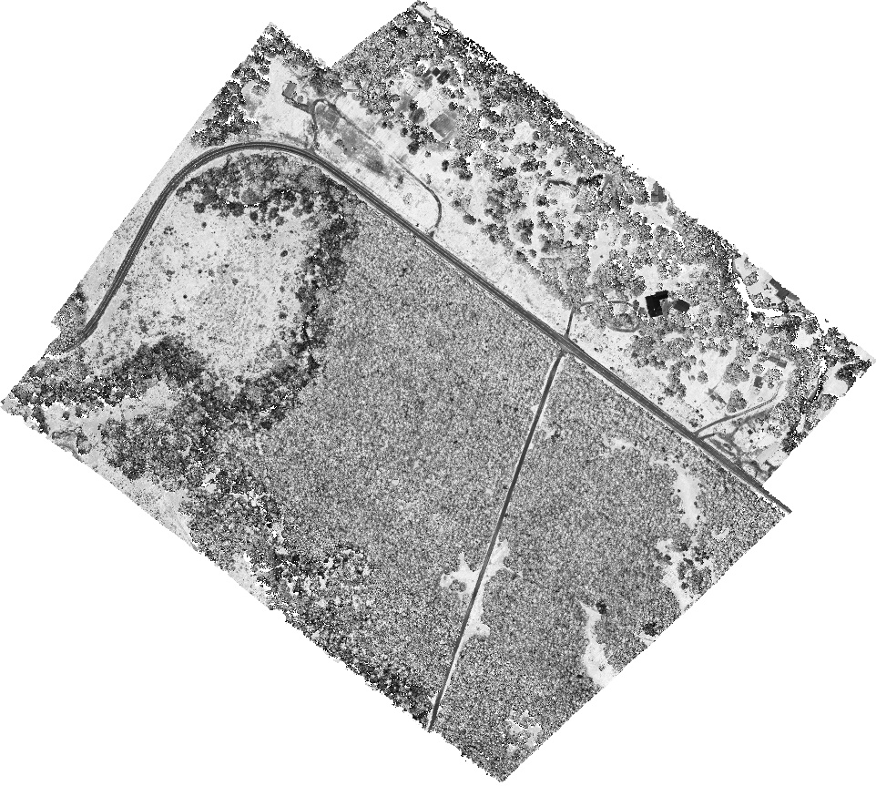
Intensity Image
Commonly unused bi-product of a LiDAR acquisition and is the intensity of object that the laser pulse is striking. This is an uncalibrated 8-bit (0-255) image that is ortho-rectified as therefore can be used as an orthophoto
Not typically used in quantitative analysis as image gains always set to 'adaptive gain' setting when images are acquired
Notes:
‹#›

Slide 7
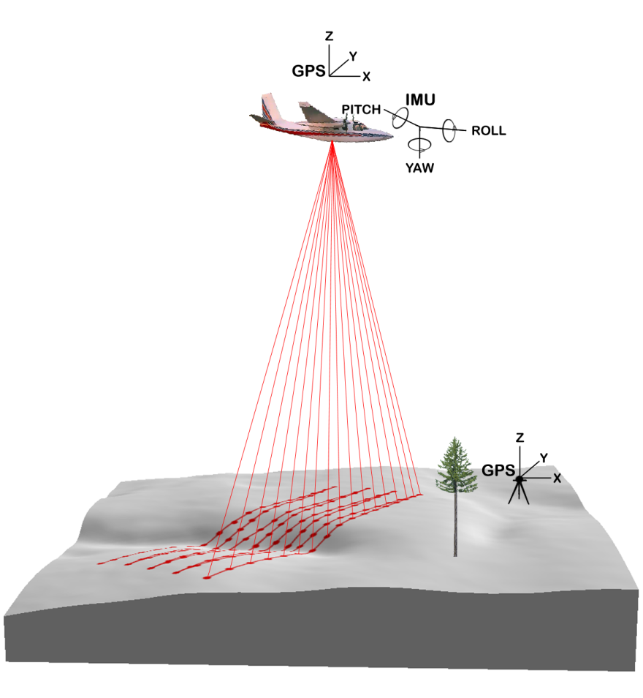
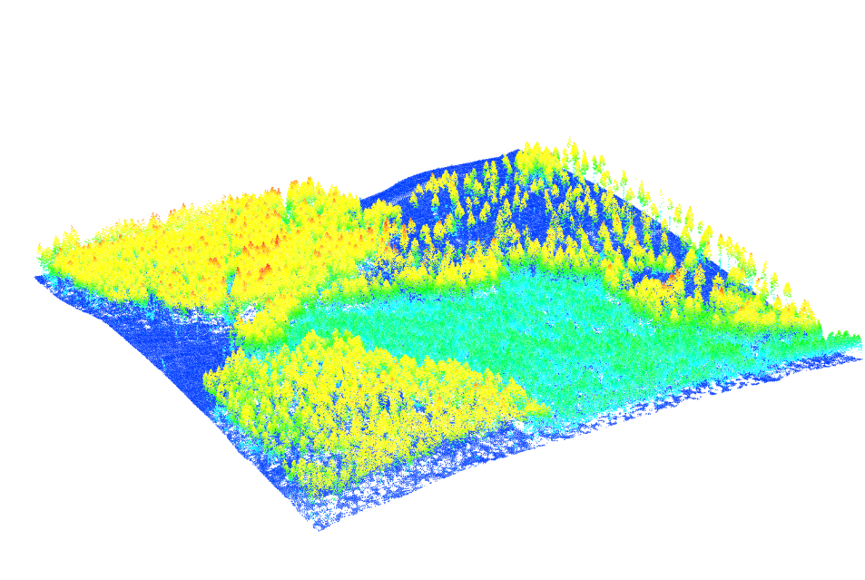
Aerial LiDAR System Components*
Aircraft
Scanning laser emitter-receiver unit
Differentially-corrected GPS
Inertial measurement unit (IMU)
Computer
LiDAR point data colored by height
*components can be sources of error…more on this in Part II
Figures from McMcGaughey
USDA Forest Service--PNW Research Station
Notes:
‹#›

Slide 8
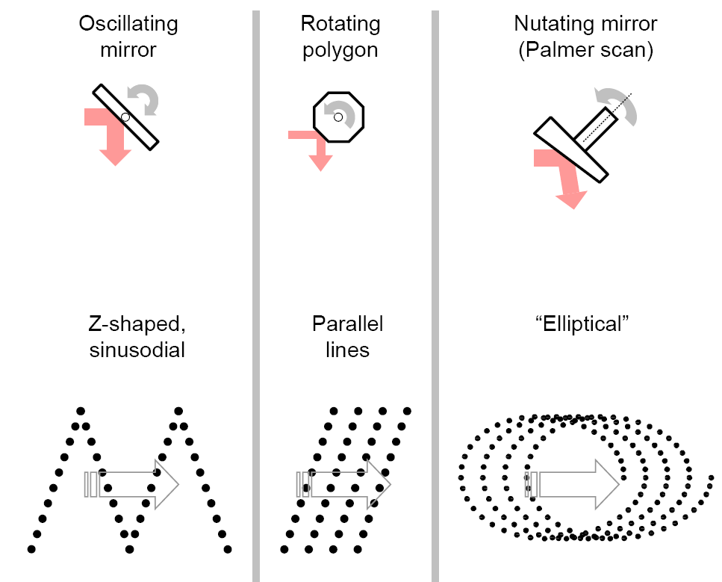
Scanning Mechanisms
Mechanism
sawtooth
Ground pattern
Most common pattern (Leica, Optech)
Figure modified from: Nikolaos 2006
Notes:
‹#›

Slide 9
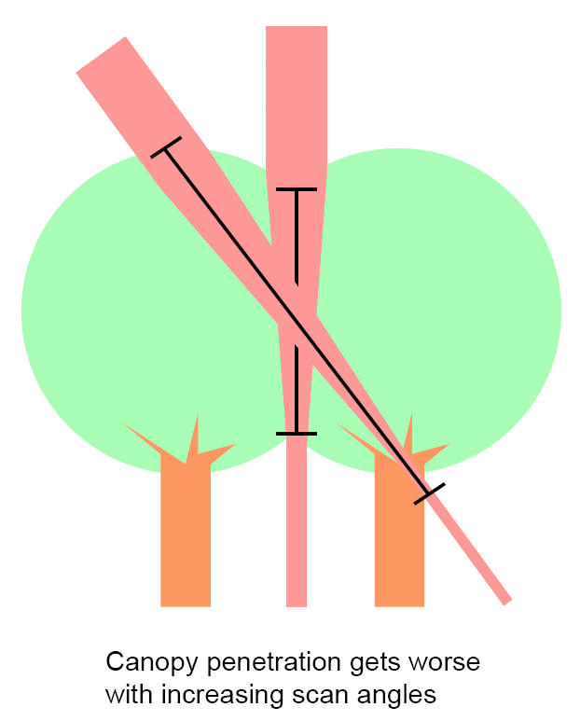
Determinants of LiDAR Data Characteristic
The combination of:
Scanner system
(relates to beam pattern)
Flight altitude
(if flight limitations exist)
Pulse rates
Scan frequencies
Scan angle
possible max around 30°
scan swath
Notes:
‹#›

Slide 10
LiDAR Data Characteristics
Raw return data are XYZ points
High spatial resolution
Laser footprint on ground ≤ 0.50 meters
Typical density is 0.5 to 20+ pulses/m²
2 to3 returns/pulse in forest areas
Surface/canopy models typically 1 to 5m grid
Large volume of data
5,000 to 60,000+ pulses/hectare
10 to100+ thousands of returns/hectare
0.4 to 5.4+ MB/hectare
Notes:
‹#›
The low number correspond to LIDAR collected for topographic mapping applications
The high numbers correspond to LIDAR collected for vegetation characterization

Slide 11
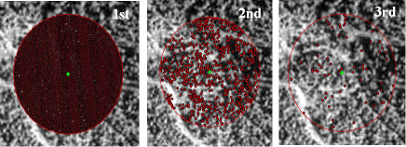
Return Density
In LiDAR the footprint size decreases with increasing post-spacing and importantly the last return from a discrete return system is not always the ground
LiDAR sensor systems vary in the number of returns from a surface
Figure Source: http://www.cnrhome.uidaho.edu/
Notes:
‹#›

Slide 12
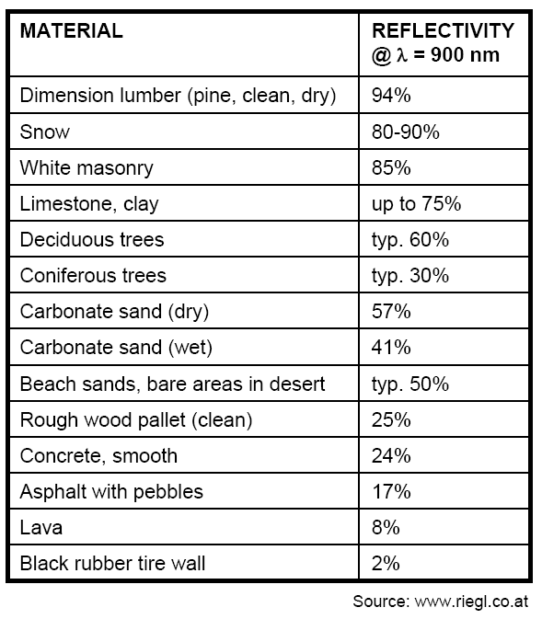
Reflectivity
Highly reflective objects may saturate some laser detectors, while the return signal from low-reflectivity objects may occasionally be too weak to register as valid
Minimum detectable object size depends on reflectivity
A strong sunlight reflection off a highly reflective target may "saturate" a receiver, producing an invalid or less accurate reading*
*most acquisition is done in a preferred range of angles to avoid this issue
Notes:
‹#›

Slide 13
Dust & Vapor
Laser measurements can be weakened by interacting with dust and vapor particles, which scatter the laser beam and the signal returning from the target
Using last-pulse measurements can reduce or eliminate this interference
Systems that are expected to work in such conditions regularly can be optimized for these environments
Notes:
‹#›

Slide 14
Background Noise and Radiation
The laser is not affected by background noise
Most systems determine baseline radiation levels to ensure that it does not interfere with measurements
Notes:
‹#›

Slide 15
Overall Accuracy
(X,Y,Z) position of each return
50-100cm horizontal
10-15cm vertical
Ground surface (bare-earth surface)
What is the ground (grass, rocks, stumps)?
Tree heights
Underestimate tree heights by 0.5 to 2 m
Error is species dependent
Notes:
‹#›

Slide 16
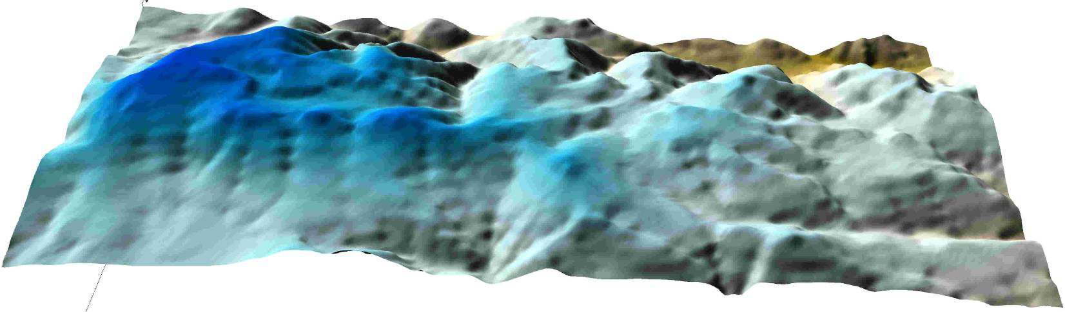
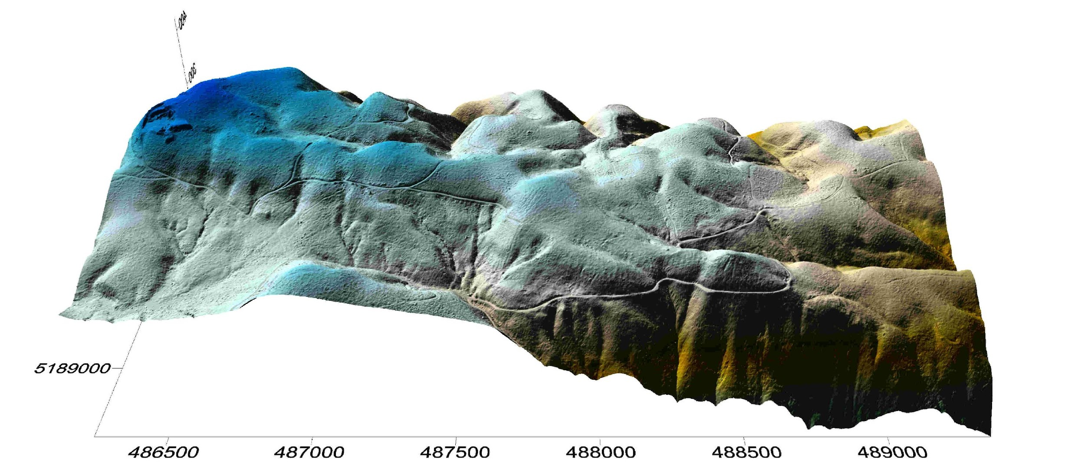
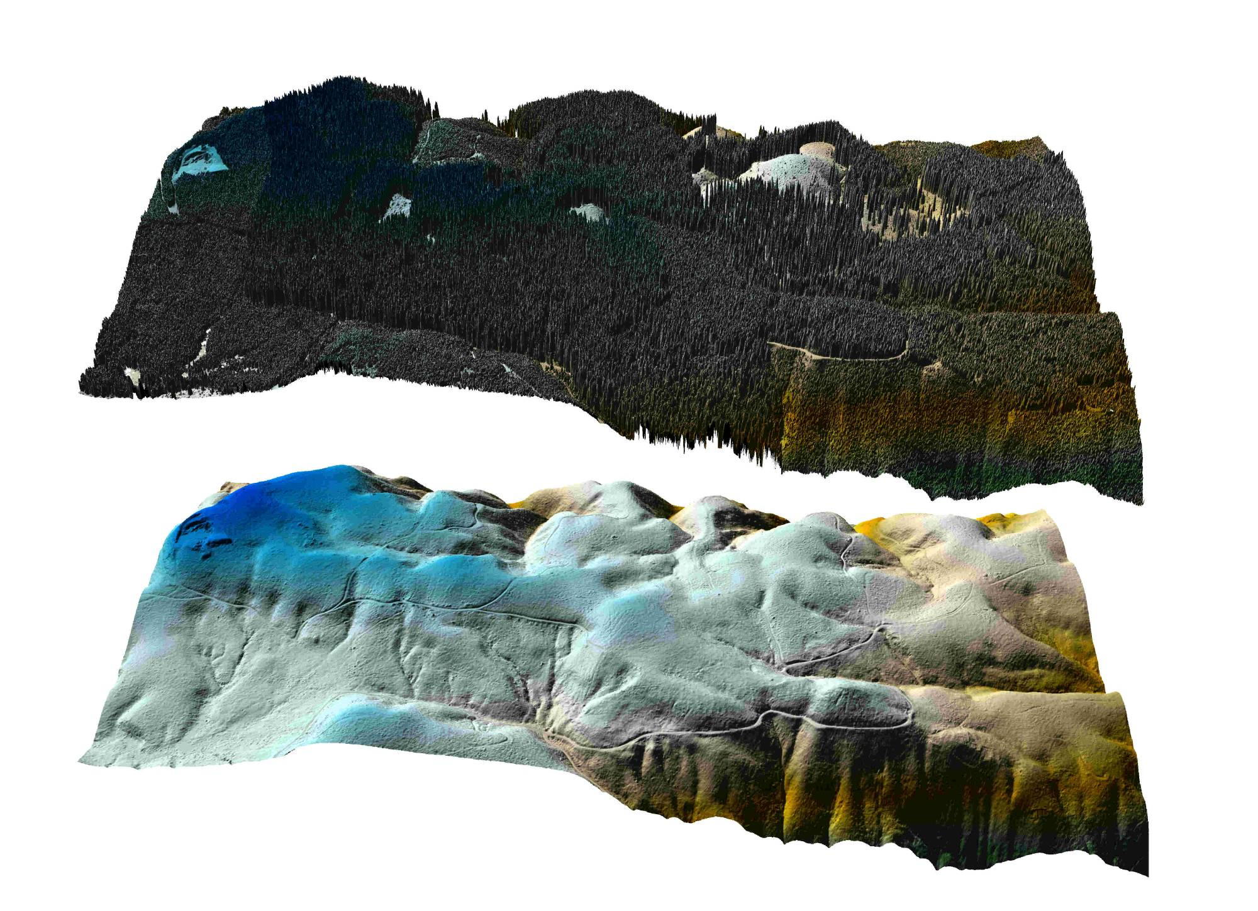

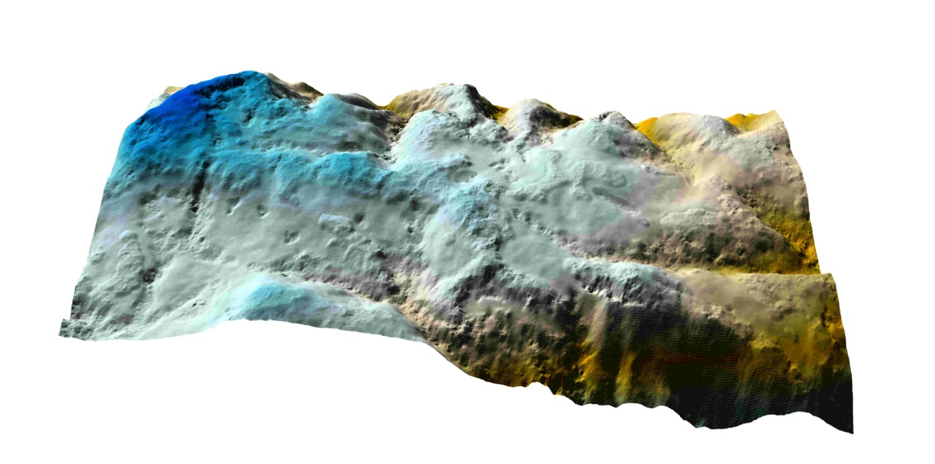
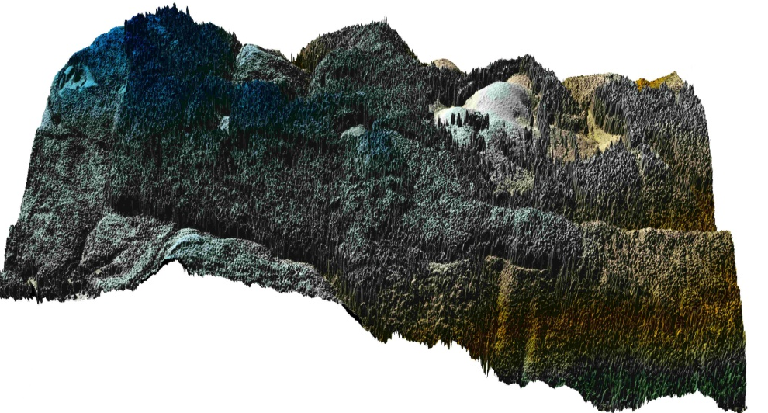
10m USGS DEM
DEM & Canopy Models
LiDAR
Streams
Landslide
LiDAR
IFSAR
IFSAR
Notes:
‹#›
Guest lecturer: Dr. L. Monika Moskal
UW Spring 2007 - ESRM490H

Slide 17
Streams
Landslide

Slide 18
Data Ordering Details
Data Acquisition | There are a number of private companies, academic institutions, and government agencies that produce and provide LiDAR data.
Timing | There are a number of time constraints associated with LiDAR collection and delivery: • Flight schedules can be delayed due to weather and environmental factors • Project areas may be large enough that multiple flights are needed • Post processing of millions of raw data points can be time consuming • Producing additional deliverables can delay the delivery schedule Leaf-on or leaf-off? (Example)
Costs | Cost can vary depending on size of project, horizontal postings (point density), and project location. Cost may also increase based on additional product requests (i.e., DEMs, DTMs, contours, etc.), specific accuracy requirements, or licensing restrictions. Most current estimated: LiDAR: $1-$4/hectare (1 hectare = ~2.5 acres) (640 acres = 1mi²) Aerial photography: pennies/ hectare (slight difference in cost for non stereo vs. stereo)
Formats | Common LiDAR Data Exchange Format - .LAS Industry Initiative (ASPRS). The LAS file format is a public file format for the interchange of LiDAR data between vendors and customers. This binary file format is an alternative to proprietary systems or a generic ASCII file interchange system used by many companies. Know & understand the flight acquisition parameters Always get the raw data (it can be reprocessed later with newer techniques/algorithms) Get an intensity image
Projections | LiDAR data can be delivered in many different projections and datums. The national standard for vertical datum is the North American Vertical Datum (NAVD 88), and the national standard for horizontal datum is the North American Datum of 1983 (NAD 83).
Licensing | Licensing restrictions vary for each LiDAR service provider. Many providers do not have restrictions on their data products, but some companies do require licensing.
Notes:
‹#›

Slide 19
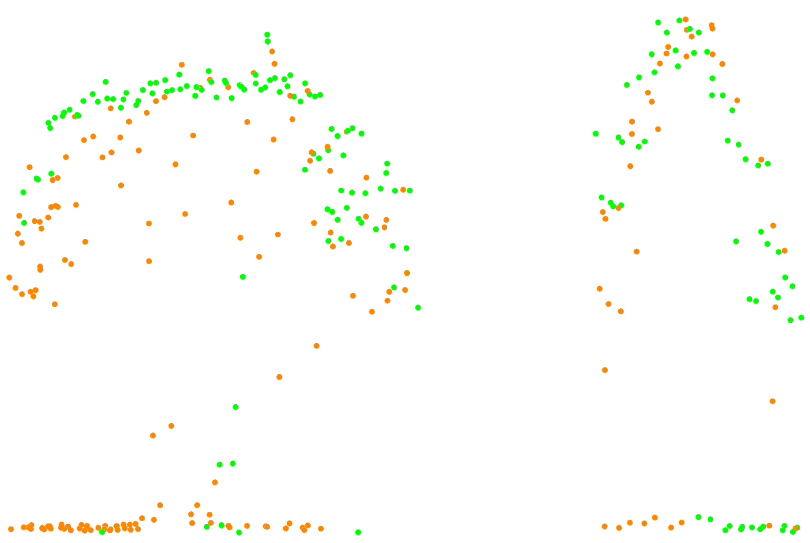
Leaf-on vs. leaf-off
(A)
(B)
Cross section of LIDAR data through a single deciduous tree (A) and coniferous tree (B) including bare-earth returns. The green dots represent leaf-on returns and the brown dots represent leaf-off returns
Notes:
UW Spring 2007 - ESRM490H
Guest lecturer: Dr. L. Monika Moskal
‹#›

Slide 20
What are some of the LIDAR data products available?
Digital Ortho-Rectified Imagery
Some LiDAR providers collect digital color or black-and-white ortho-rectified imagery simultaneously with the collection of point data. Imagery is collected either from digital cameras or digital video cameras and can be mosaiced. Resolution is typically 1m.
Intensity Return Images
Images may be derived from intensity values returned by each laser pulse. The intensity values can be displayed as a gray scale image.
LIDAR Derived Products
Topographic LiDAR systems produce surface elevation x, y, z coordinate data points. There are many products that can be derived from raw point data. Most LiDAR providers can derive these products upon request:
Digital Elevation Models (DEMs)
Digital Terrain Models (DTMs) (bald-earth elevation data)
Triangulated Irregular Networks (TINs)
Breaklines - a line representing a feature that you wish to preserve in a TIN (example: stream or ridge)
Contours
Shaded Relief
Slope & Aspect
Notes:
‹#›

Slide 21
LiDAR Fundamentals: Part Two L. Monika Moskal, PhD Assistant Professor - Remote Sensing & Biospatial Analysis College of Forest Resources & Precision Forestry Cooperative University of Washington Workshop on Site-scale Applications of LiDAR on Forest Lands in Washington Center for Urban Horticulture, UW Thursday, January 3, 2008
Notes:
‹#›

Slide 22
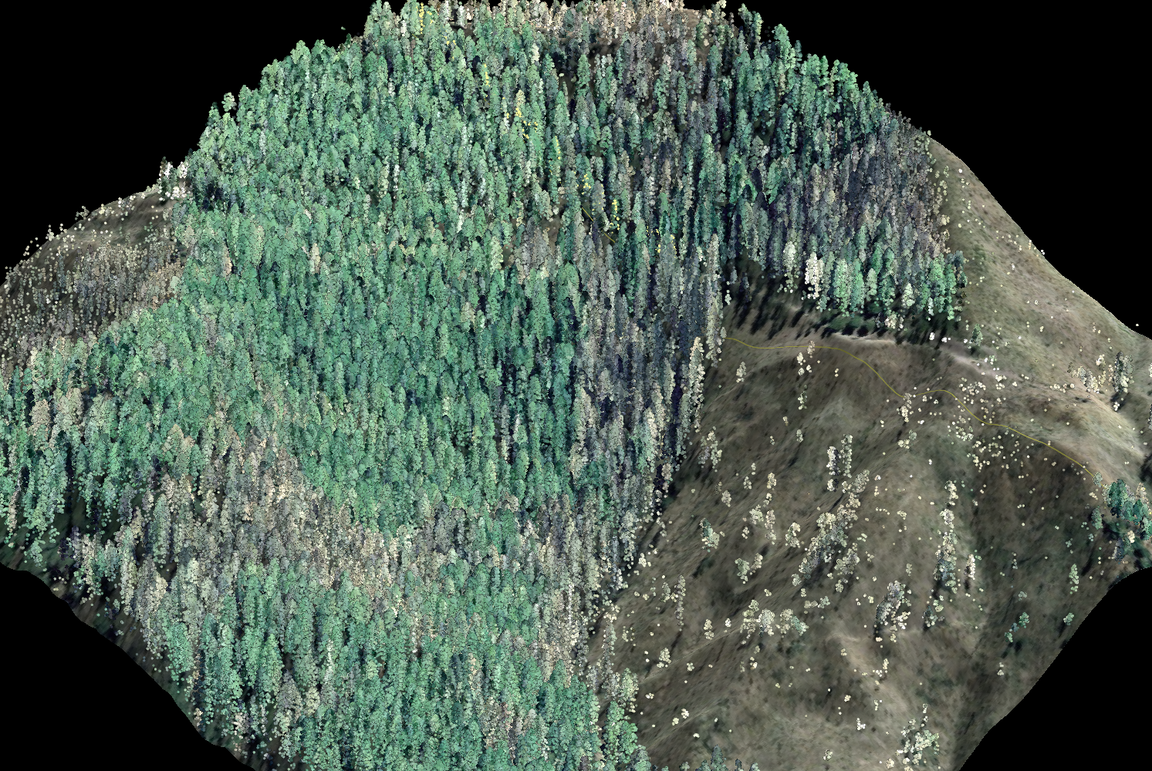
Notes:
‹#›

Slide 23
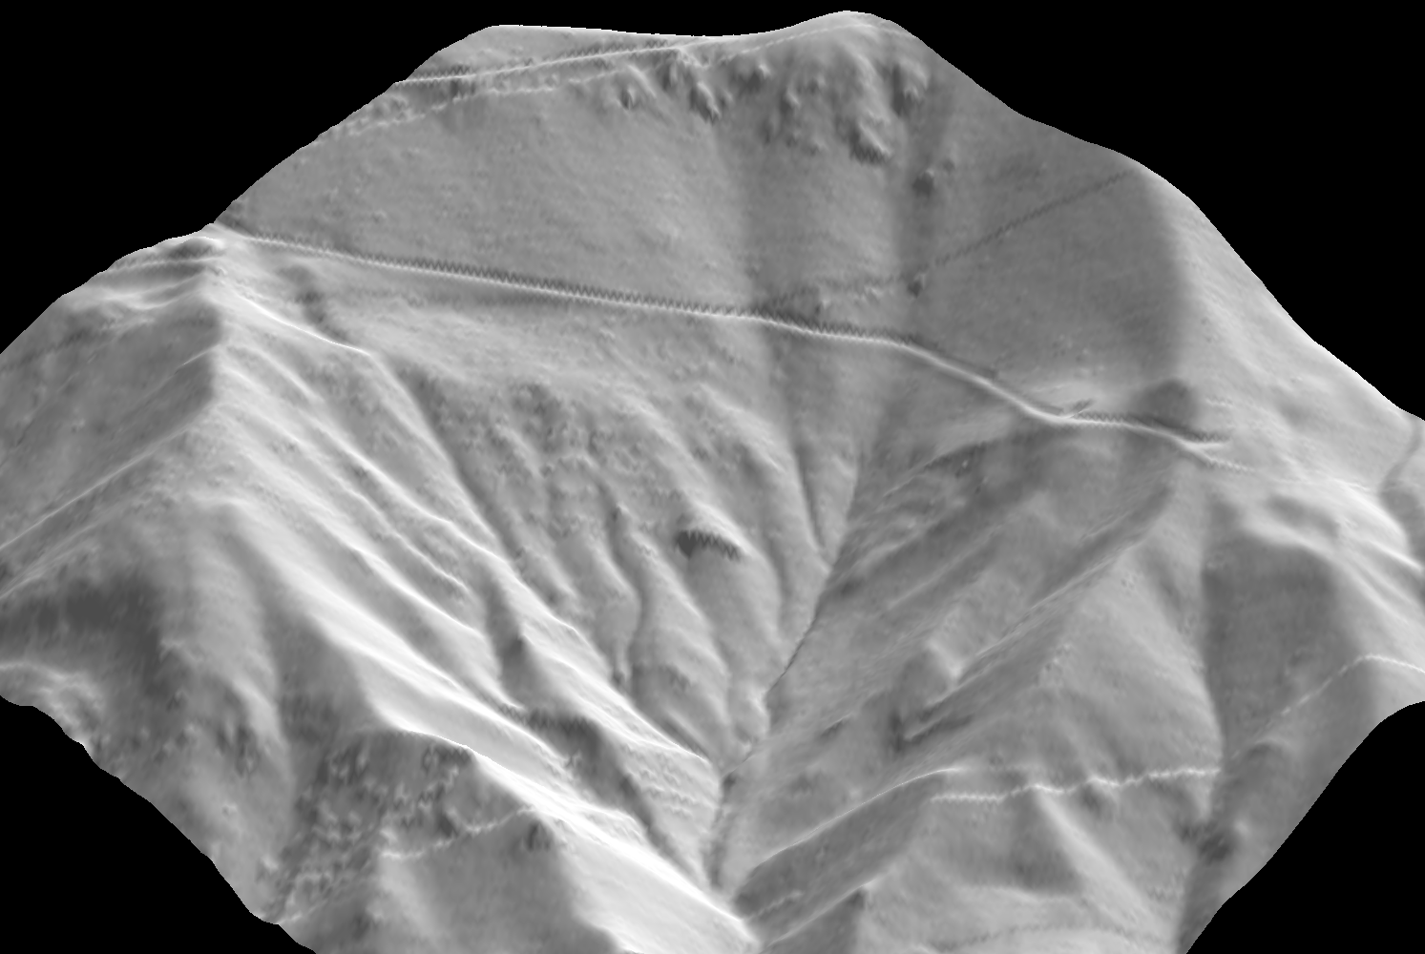
Notes:
‹#›

Slide 24
Sources of Error
Acquisition
Processing
Strip adjustment
Selecting ground points
Thinning
Interpolation
Analysis/Visualization
Notes:
‹#›

Slide 25
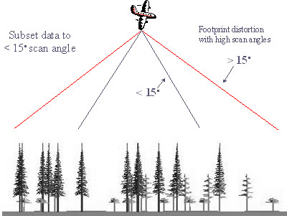
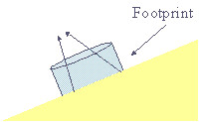
Acquisition Scan Angle
LiDAR data should be acquired within 18º of nadir as above this angle the LiDAR footprint can become highly distorted
Complex terrain can exascerbate the problem
Notes:
‹#›

Slide 26
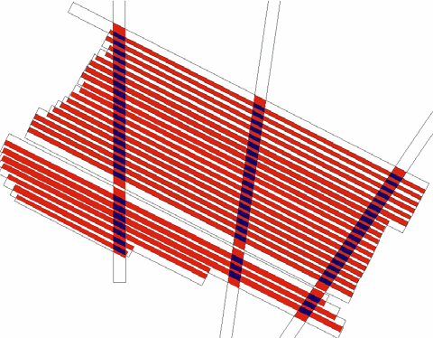
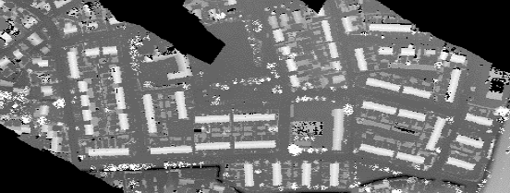
Strip Adjustment
Systematic Error (shifts & drifts)
- Wrong or inaccurate calibration of entire measurement system (block specific)
- Limited accuracy of exterior orientation (GPS- & IMU-related time- and location-specific)
Result: Point cloud will not lie
on ground, but is offset in planimetric view and height (10’s of cm)
For removing these discrepancies strip adjustment algorithms require quantification of these offsets at various locations
Improvements are needed in automatic tie elements detection & 3D adjustments
Manual effort and labor are time consuming
Ditches & ridges are useful
Improves planimetric accuracy by about
40% and height accuracy by about 25%
Data correction and quality control tool
Overlap, across-track flight lines and ground control are needed to fully adjust the systematic errors
Create a seamless data set by correcting for the systematic errors
Notes:
Constructional measures
• Highly stable mechanics, low drift in electronics, highly accurate time sync.,
internal reference measurement …
• Calibration
• Factory calibration of laser scanner, GPS/INS alignment …
• Flight specific measures
• Good satellite constellation, close reference station, little turbulence …
• Still systematic errors will remain, especially visible at strip overlaps
‹#›

Slide 27
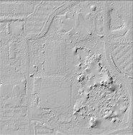
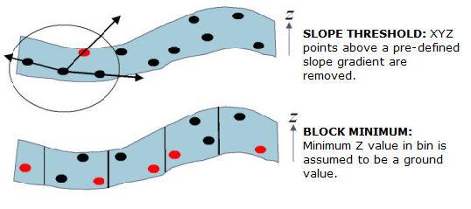
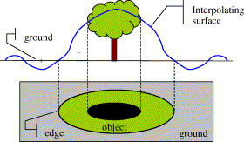
Selecting Ground Points
Result of 'slope threshold' applied to an urban area (from Vosselman 2000)
Active area of research
Many algorithms
Project specific
Manual clean up necessary in most cases
Notes:
‹#›

Slide 28
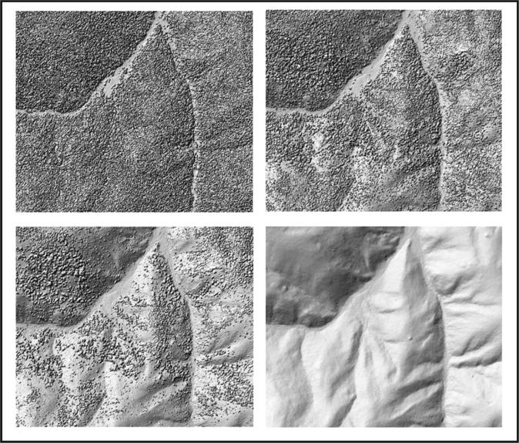
Getting Down to the Ground
Progressive Curvature Filter (Evans and Hudak 2007)
Notes:
Basic approaches
• Mathematic morphology
• Progressive refinement
• Linear prediction
• Segmentation
• Points / local neighbourhood vs. segments
Morphologic operators and slope based filtering
(Vosselman, 2000)
• Linear prediction and hierarchic robust interpolation
(Kraus & Pfeifer 1998, Pfeifer et al. 2001)
• Progressive TIN densification (Axelsson, 2000)
• Segmentation based filtering
(Sithole, Vosselman 2005)
‹#›

Slide 29
Filtering
Post ground point selection filtering is also performed to reduce the size of the data sets
This type of filtering should only be applied in even terrain
Uneven terrain and densely vegetated areas are most susceptible to removal of critical interpolation points
Notes:
‹#›

Slide 30
Terrain
• Digital elevation model (DEM), digital terrain model (DTM): “Ground”
• Digital surface model (DSM): “top surface”
• In open terrain, the separation surface between air and bare earth
• DEM is different from measured laser points due to very different reasons:
Filtering: classification of points into terrain and off-terrain
Basis for DTM generation, detection of topographic objects
Notes:
‹#›

Slide 31

Interpolation
Many algorithms
Propagates inherent errors in the data
Sensitivity to spatial distribution and local lack of points
Can introduce artifacts
Using incorrect scale (over smoothing)
Interpolation error
Notes:
From point data or TIN to RASTER
‹#›

Slide 32
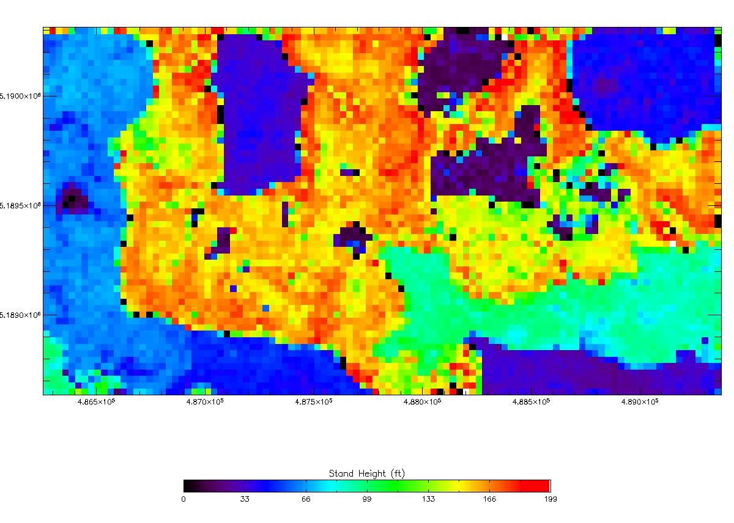
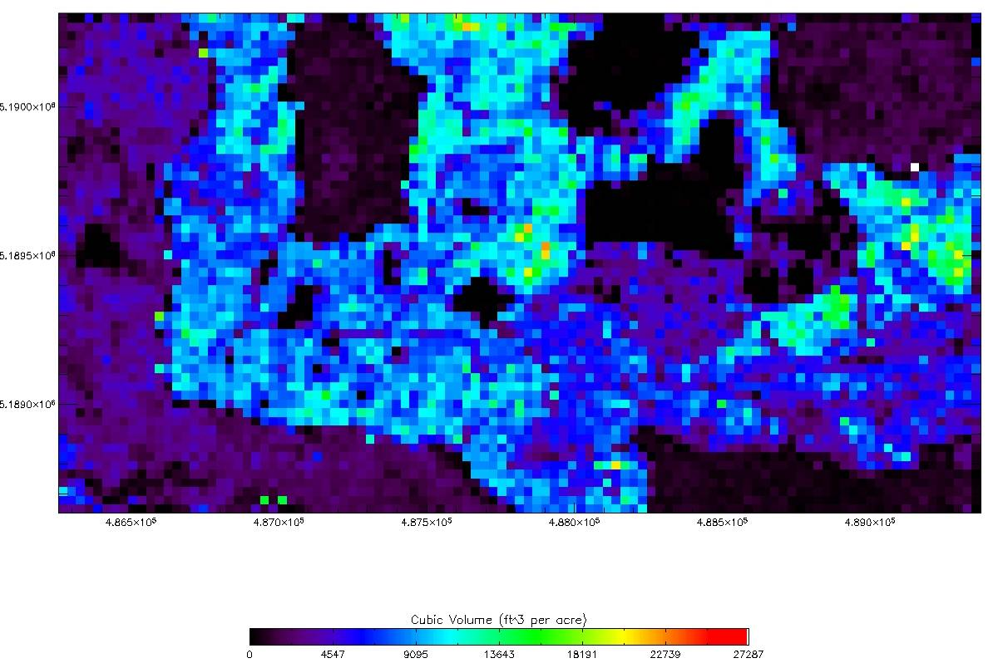
Example: Mapping forest attributes across landscapes
Stand height at Capitol Forest study site (30 m cells)
Stem volume (30 m cells)
Cross hatched polygon = 1 FIA plot (averaged observation)
Notes:
‹#›
Research collaboration with Precision Forestry Cooperative
Hans-Erik Andersen
Funding support from:
USFS-PNS Station
Fort Lewis
JFSP
Others
Guest lecturer: Dr. L. Monika Moskal
UW Spring 2007 - ESRM490H

Slide 33
Other Considerations
LiDAR derived DEM are not often hydro-corrected so as to ensure a continuous downward flow of water (no Digital Line Graph (DLG) hypsographic and hydrographic data)
Water creates a natural void in LiDAR data and manual addition of breadlines is necessary
This type of processing is feasible with LiDAR data but it adds cost
Notes:
‹#›

Slide 34
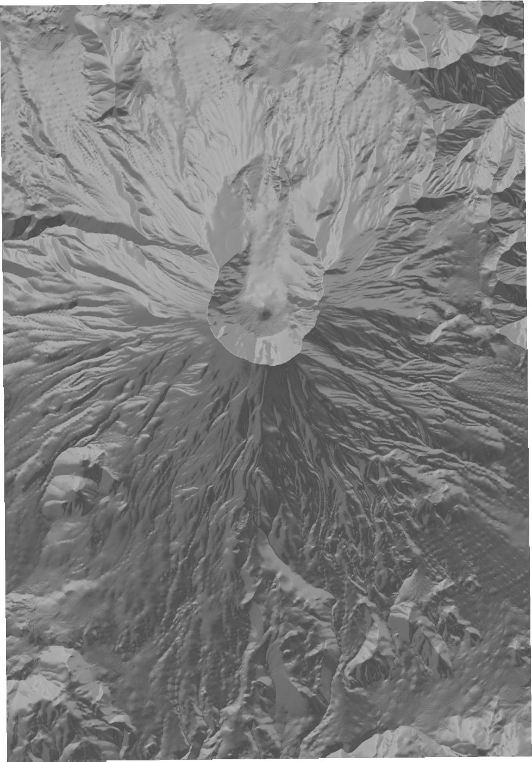
Visualization
Shaded relief & DEM illumination can be used as a simple visualization technique
These methods are subjective
Sensitive to hardware parameters
Notes:
‹#›

Slide 35
Further Analysis & Ground Validation
Once the DTM or DEM is available GIS can be utilized for further systematic analysis and modeling
Accuracy assessment should always be attempted (best approach is to do ground validation)
Notes:
‹#›

